Slide 1
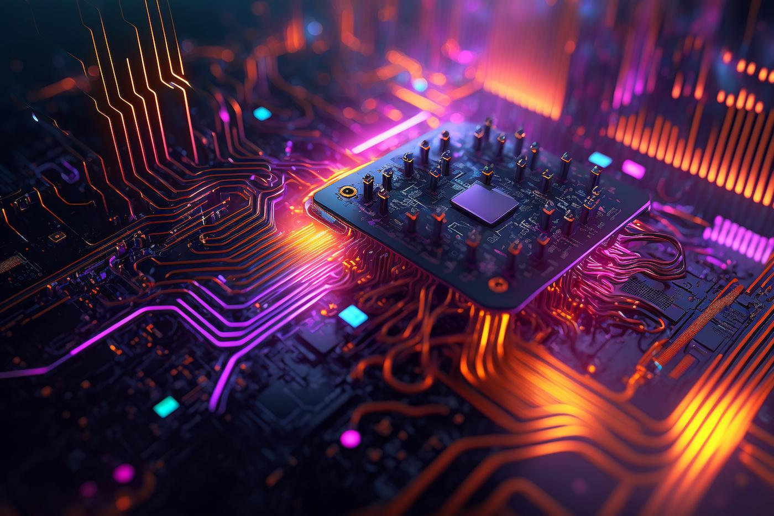


TechDay India 2023
Ravi Prakash
Performance Engineering
Generative AI For Performance Engineering
“ Performance Engineering & Generative AI are the dynamic duo that optimize system performance , enhance user experience and drive business success in the ever-evolving digital world.”

Slide 2


Introduction
Today’s Agenda
Welcome to the presentation on "Leveraging Generative AI for Enhanced Performance Engineering at Verizon”.
Why we Need Generative AI in Performance Engineering
Solution - Leveraging Generative AI in Performance Engineering
Implementation Approach and Proof of Concept(PoC)
Conclusion - Empowering Performance Engineering with Generative AI
Notes:
Link to issue Log:

Slide 3
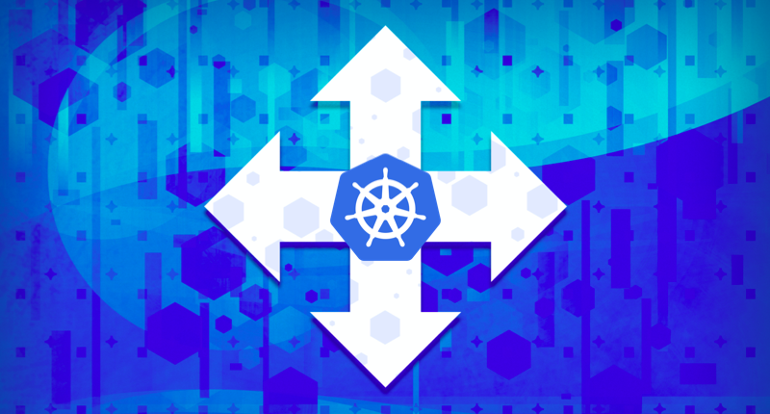
Need for Generative AI in Performance Engineering
Infrastructure Side:-
Specific Problem 1: Manual calculation of pods and infrastructure resources leads to inaccuracies.
Impact: Inefficient resource allocation, potential performance bottlenecks, and increased costs.
Challenges: Complex workload patterns and dynamic traffic demand hinder accurate resource estimation.
Client Side:-
Specific Problem 2: Manual calculation of virtual users (VUs), load, and TPS results in suboptimal test scenarios.
Impact: Incomplete test coverage and potential performance regressions.
Challenges: Difficulty predicting real-world user behavior and varying traffic patterns.

Slide 4
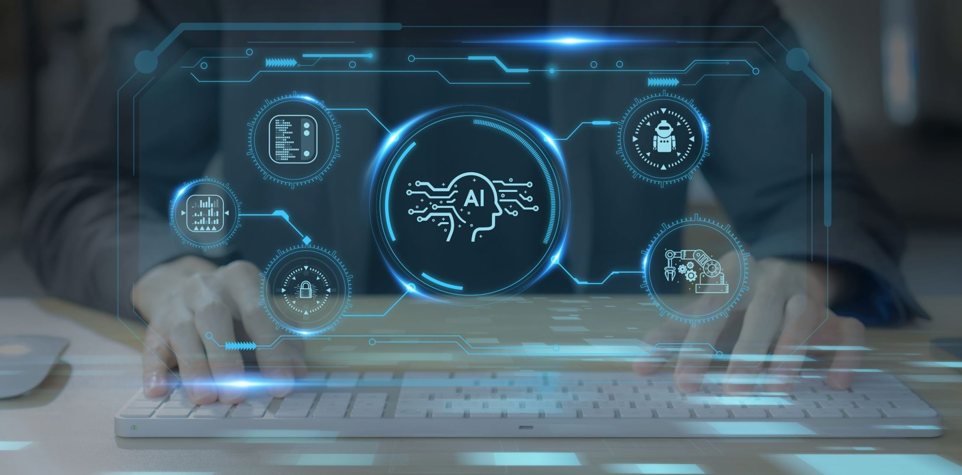
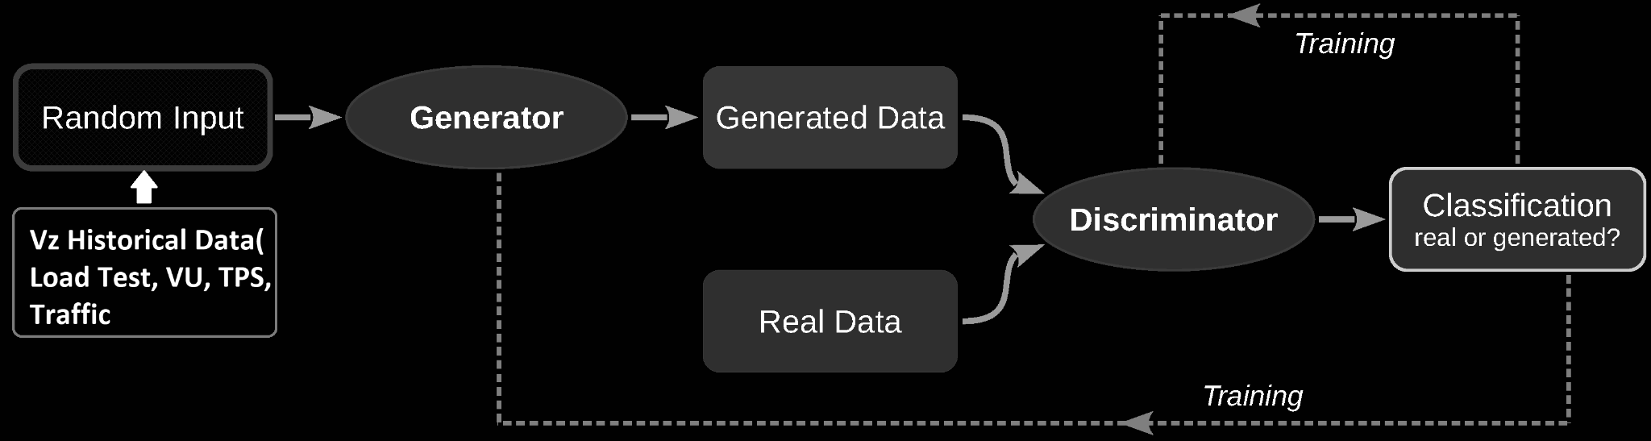
Solution - Leveraging Generative AI in Performance Engineering
Specific Solution to Problem 1
Predict Future Demand
Dynamic Resource Allocation
Prevent Performance Bottlenecks
Techniques Used:
1. Generative adversarial networks (GANs)
2. Variational autoencoders (VAEs)
3. Natural language processing
4. Time Series Forecasting
Specific Solution to Problem 2:
Generative Synthetic User Traffic
Synthetic Load Generation
Precise Test Scenarios
Techniques Used:
1. Reinforcement learning
2. Deep reinforcement learning
3. Multi-task learning
Notes:
Introduction - 1 min
Problem Statement - 2 mins
Inputs and implementation Stapes - 2 mins
Output & Benefits- 2 mins

Slide 5

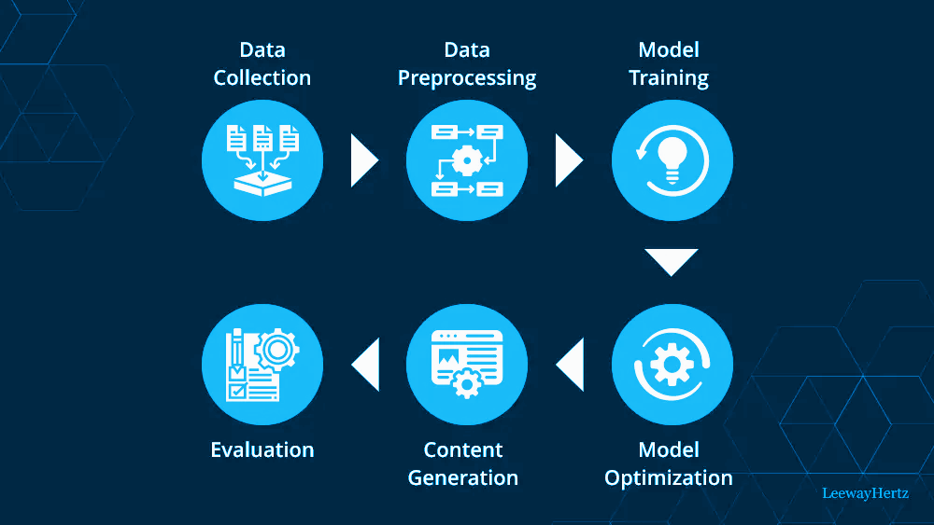
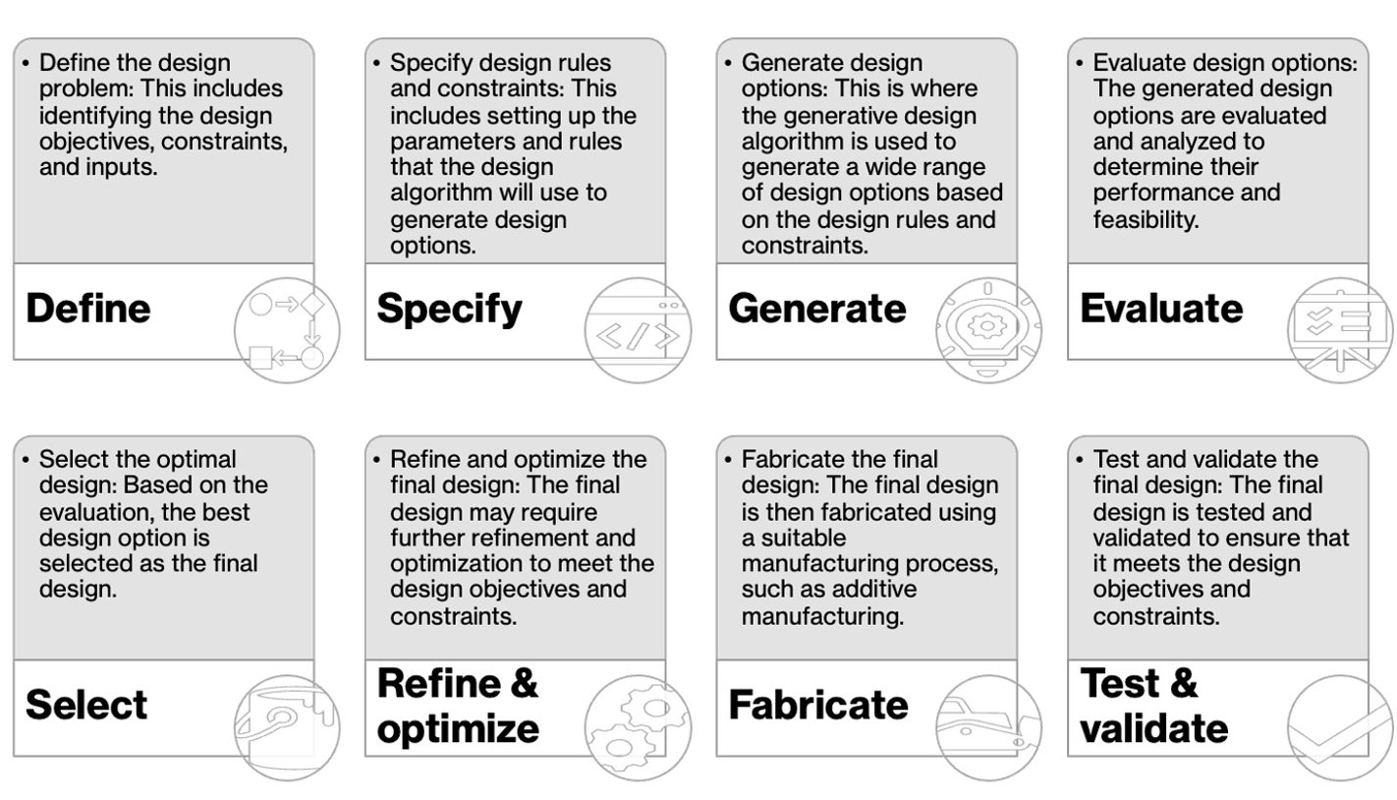
Implementation Approach and Proof of Concept(PoC)
Implementation for both Infrastructure & Client Side:
Data Collection: Gather historical load test data and infrastructure metrics. (Kibana, NewRelic, Grafana etc)
Generative AI Model Training: Train GANs or VAEs on data to learn workload patterns and correlations.
Real-time Resource Allocation: Implement Generative AI for dynamic resource allocation.
Synthetic Load Generation: Use Generative AI-generated synthetic VUs and workloads for testing.
PoC Evaluation: Assess accuracy and efficiency of Generative AI-driven resource allocation.
Notes:
Link to issue Log:

Slide 6
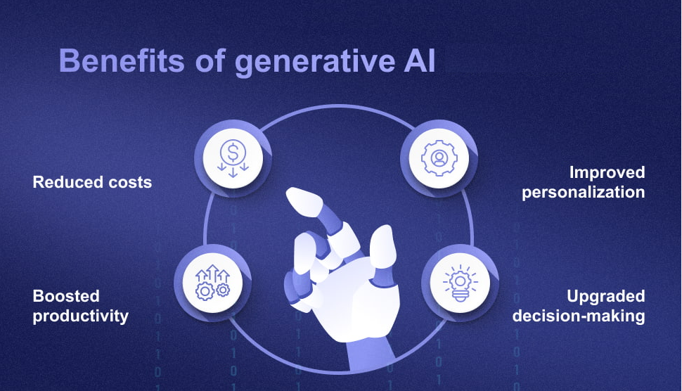
Conclusion - Empowering Performance Engineering with Generative AI
Notes:
Link to issue Log:

Slide 7



Slide 8

Thank you

